Slide 1
Modeling Combinational Circuits Input/Output Data Types

Slide 2
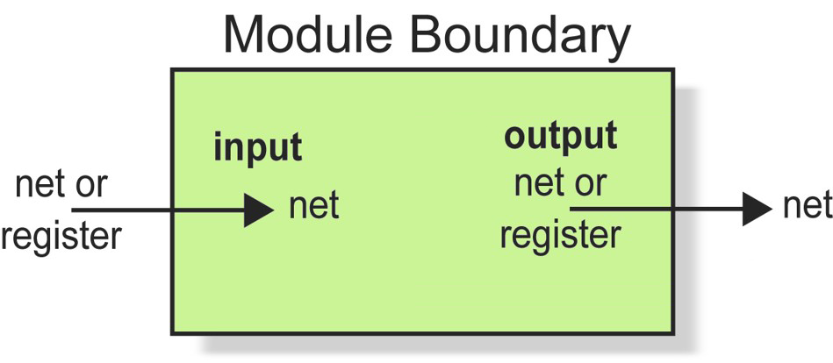
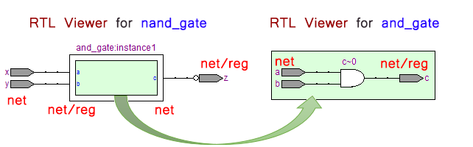
Module Ports

Slide 3
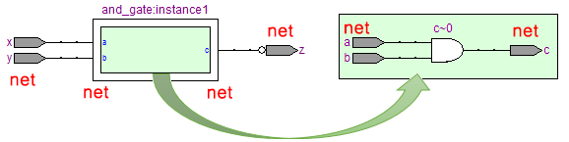
Example#1
module nand_gate(x, y, z);
input x, y;
output z;
wire zBar;
wire p, q;
assign p=x;
assign q=y;
and_gate instance1(p, q, zBar);
assign z= ~ zBar;
endmodule
module and_gate(a, b, c);
input a, b;
output c;
assign c= a & b;
endmodule

Slide 4

Example#2
module nand_gate(x, y, z);
input x, y;
output z;
wire zBar;
wire p, q;
assign p=x;
assign q=y;
and_gate instance1(p, q, zBar);
assign z= ~ zBar;
endmodule
module and_gate(a, b, c);
input a, b;
output reg c;
always @(*)
c = a & b;
endmodule

Slide 5
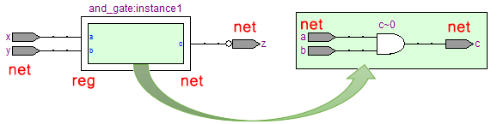
Example#3
module nand_gate(x, y, z);
input x, y;
output z;
wire zBar;
reg p, q;
always @(x,y)
begin p=x; q=y; end
and_gate instance1(p, q, zBar);
assign z= ~ zBar;
endmodule
module and_gate(a, b, c);
input a, b;
output c;
assign c= a & b;
endmodule

